Slide 1


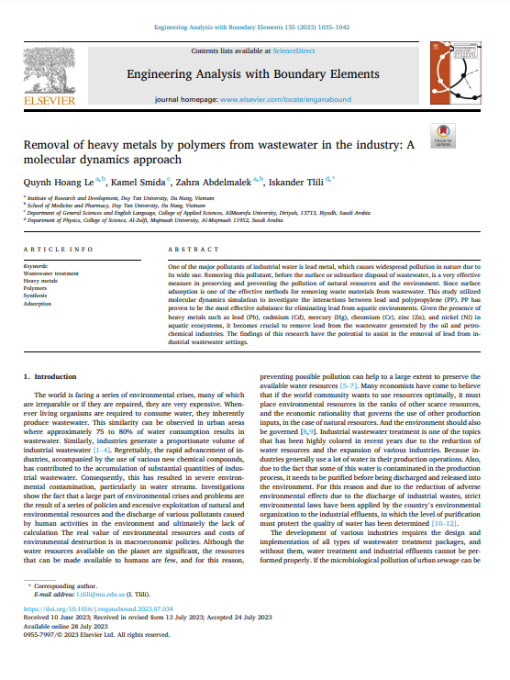

0
Removal of heavy metals by polymers from wastewater in the industry: A molecular dynamics approach
CL311-Technical writing and presentation
Presented by:-
Ravi Bhushan Pratap
Roll No.-210107070
Group No.- 28
13,Sep,2023

Slide 2
Content
1
Introduction
Objective
Materials and Method
Results and Discussions
Conclusion
Future Works
Reference

Slide 3

Introduction
2
Irreparable environmental crises are plaguing the world.
Effects on Children and Growth:
Heavy metal poisoning has severe effects on growth and development, especially in children.
Children are more vulnerable to heavy metal exposure through food and water.
Adsorption as an Effective Separation Method:
Adsorption is a highly effective method for removing heavy metals.
Molecular dynamics simulation is a cost-effective way to study different adsorbents' abilities to remove heavy metals.
Environmental Crises and Wastewater:
Water resources are vast but scarce for human use; preventing pollution is vital for preserving available resources.

Slide 4
3
Objective
Emphasizes the health and ecological risks associated with heavy metal contamination.
Mentions the use of adsorption, specifically the PP polymer, to remove heavy metals.
States the objective of deepening understanding of the lead adsorption mechanism.

Slide 5
Methodology
4
1.Simulation Details
Four simulations were performed, each with a different PP polymer concentration (10%, 15%, 20%, and 25%).The polymer chains were modeled using a united-atom force field.
LAMMPS software was used for the simulations.
A cubic simulation box with a length of 8 nm was created.
Initially, the simulation box was filled with water molecules, and counterions were added to ensure charge neutrality.

Slide 6
Methodology
5
2. Analysis Techniques:
Gyration radius analysis to measure polymer compactness.
RMSD analysis to assess the deviation of polymer structures from their initial configurations.
RMSF analysis to examine atomic fluctuations around their average positions.
SASA analysis using the Shrake-Rupley algorithm to estimate solvent-accessible surface area.
Analysis illuminated PP polymer structural and energetic variations in diverse conditions.

Slide 7
Result and Discussion
6
Gyration Radius Analysis:
Gyration radius analysis is a valuable method for studying the spatial arrangement and structural changes in molecules and polymers. It provides insights into system size, stability, and temporal variations.
Analyzed across five polymer concentrations, revealing temporal variations. The average gyration radius varied among concentrations, indicating distinct spatial distributions.
Certain concentrations demonstrated a higher capacity to adsorb heavy metals, suggesting a link between spatial distribution, conformational changes, and adsorption capacity.

Slide 8
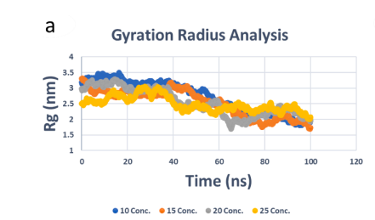
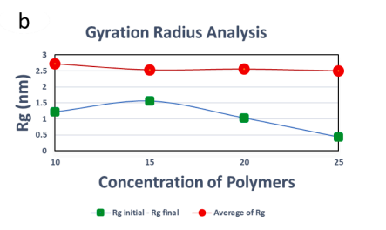
Result and Discussion
7
Chart a is time-dependent Rg analysis for different simulations.
Chart b is differential of the initial and final Rg and the average Rg for the simulations.

Slide 9
Result and Discussion
8
Energy analysis for different polymer concentrations reveals trends.
Concentration 15 exhibits the lowest energy values, indicating favorable energetics.
Average energy values vary significantly with polymer concentration.
VDW energy dominates, but electrostatic contribution becomes more important at higher concentrations.
Insights into molecular system energetics and implications for material design and optimization.

Slide 10
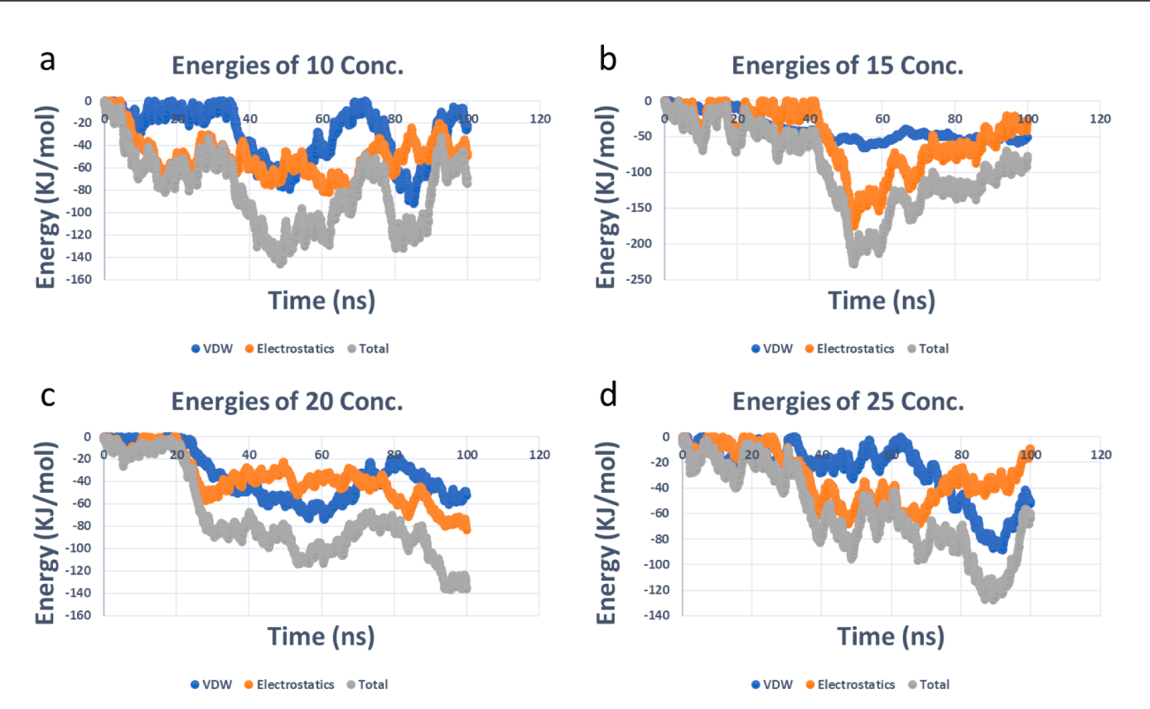
Result and Discussion
9
Time-dependent analysis of and electrostatic and van der Waals (VDW) energies, as well as the total, for various concentrations.

Slide 11
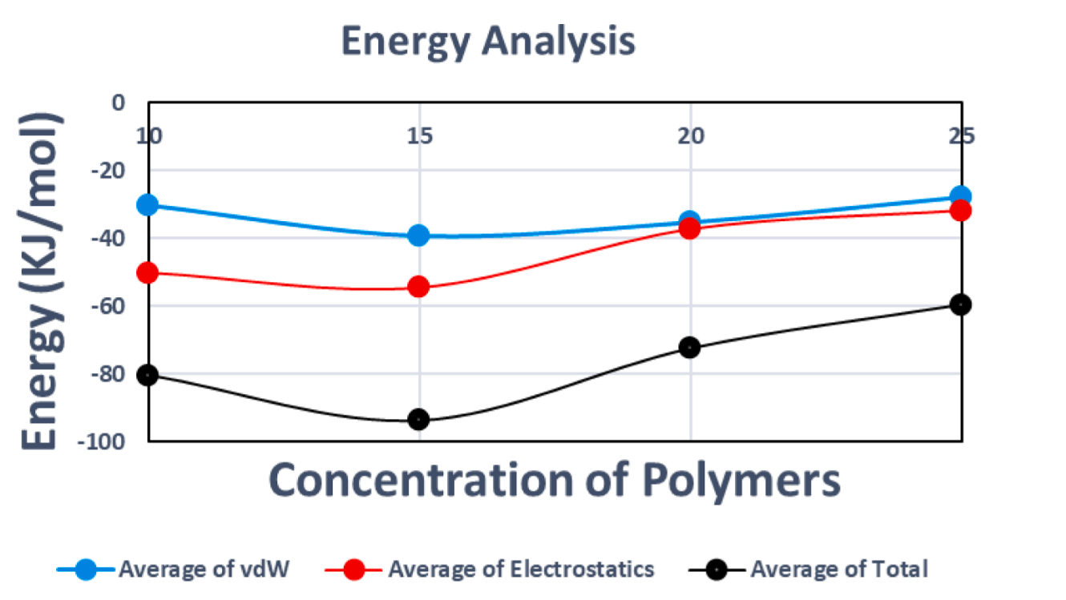
Result and Discussion
10
Average analysis of electrostatic, total, and van der Waals (VDW) energies. Blue bar: average VDW energy, Red bar: average electrostatic energy, Black bar: average total energy.

Slide 12
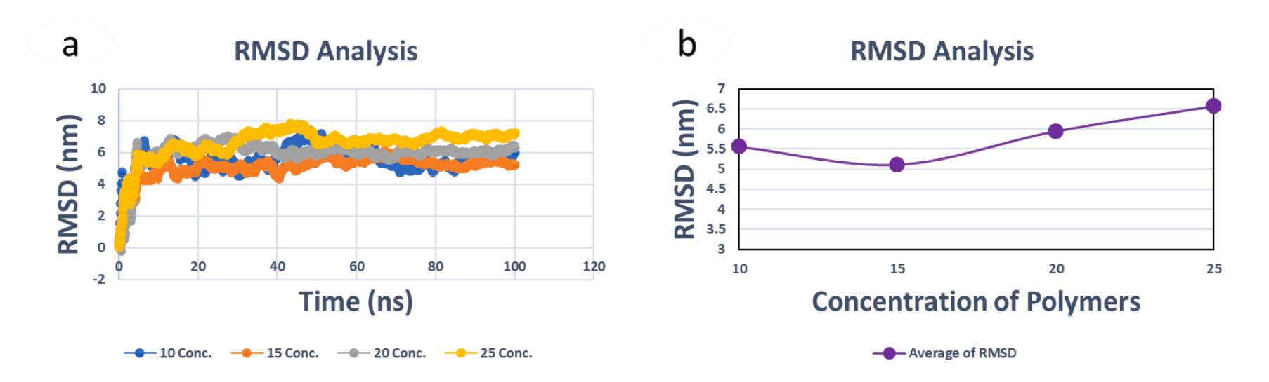
Result and Discussion
11
Chart a: time-dependent analysis of root-mean-square deviation (RMSD) for different polymer concentrations. Chart b: average RMSD analysis.

Slide 13
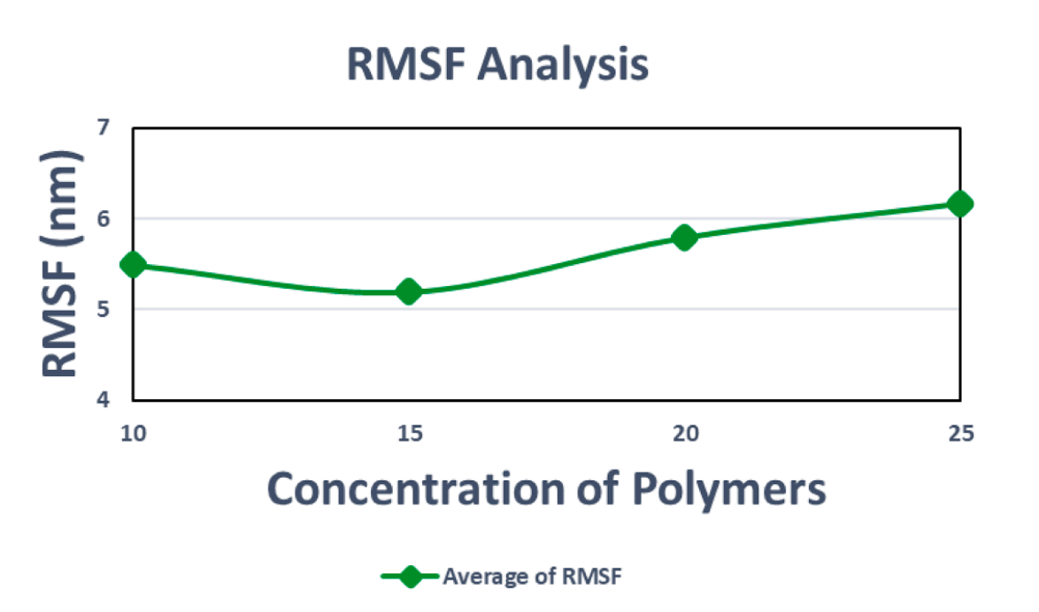
Result and Discussion
12
Average analysis of RMSF for different polymer concentrations in the simulations.

Slide 14
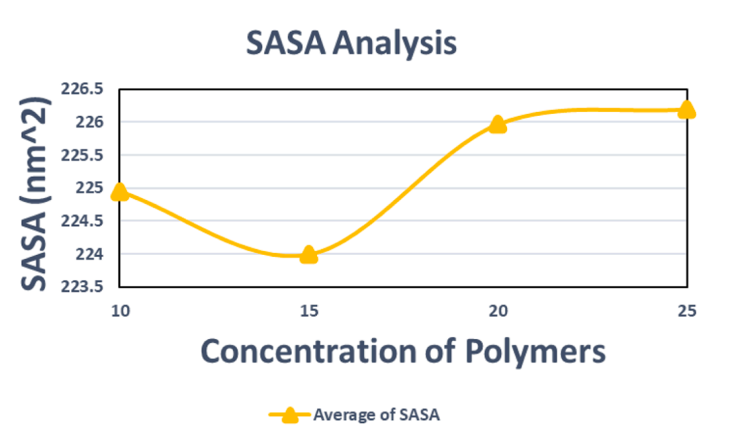
Result and Discussion
13
Average analysis of solvent-accessible surface area (SASA) for different polymer concentrations in the simulations.

Slide 15
Conclusions
14
Proper wastewater management is crucial in industries like oil and petrochemicals.
Contaminated industrial wastewater can harm the environment and human health if not treated.
Molecular dynamics simulations studied polypropylene's (PP) capacity to adsorb lead from effluents.
PP demonstrated a strong affinity for lead and stability in water environments. It is a promising material for lead removal in petroleum and petrochemical wastewater.
This research reduces the need for expensive lab experiments and toxic exposure.

Slide 16
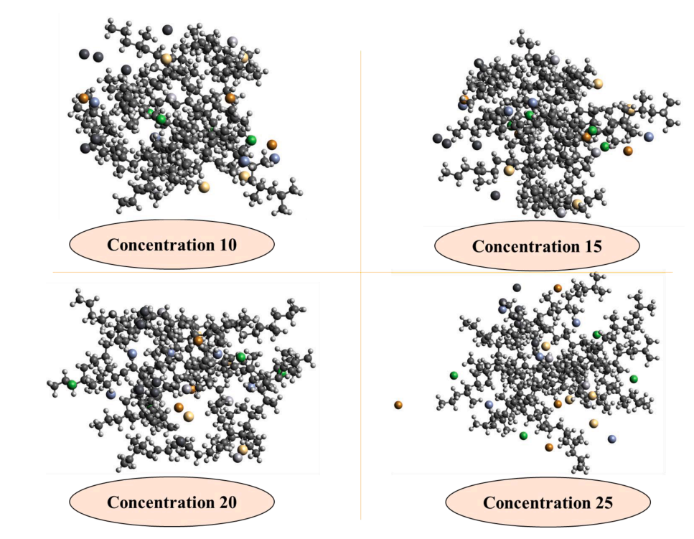
Conclusion
15
Final frame of simulations at the different concentrations. Polymer is PP and heavy metals include Lead (Pb), Mercury (Hg),Zinc (Zn), Chromium (Cr), Cadmium (Cd), and Nickel (Ni).

Slide 17
Future Works
16
Exploration of Other Adsorbents: Future research should investigate alternative adsorbents like zeolite, biomass, polymers, and composites to assess their efficiency in heavy metal removal.
Optimizing Adsorption Processes: Research should optimize adsorption processes using diverse adsorbents, considering parameters like contact time, pH, temperature, and dosage, while developing practical application guidelines.
Environmental Impact Assessment: Essential future research involves evaluating environmental impacts of wastewater treatment methods, focusing on sustainability, energy use, waste generation, and ecosystem effects.

Slide 18
Reference
17
[1] Van Vliet MT, et al. Global water scarcity including surface water quality and expansions of clean water technologies. Environ Res Lett 2021;16(2):024020.
[2] Salgot M, et al. Criteria for wastewater treatment and reuse under water scarcity. Handbook of drought and water scarcity. CRC Press; 2017. p. 263–82.
[3] Zhang Y, Shen Y. Wastewater irrigation: past, present, and future. Wiley Interdiscip Rev 2019;6(3):e1234.
[4] Ungureanu N, Vl˘ aduț V, Voicu G. Water scarcity and wastewater reuse in crop irrigation. Sustainability 2020;12(21):9055.
[5] Pandey A, et al. Utilization of solar energy for wastewater treatment: challenges and progressive research trends. J Environ Manage 2021;297:113300.
[6] Zhang D, et al. Water scarcity and sustainability in an emerging economy: a management perspective for future. Sustainability 2020;13(1):144.
[7] Obotey Ezugbe E, Rathilal S. Membrane technologies in wastewater treatment: a review. Membranes 2020;10(5):89. [8] Ibrahim I, et al. Semiconductor photothermal materials enabling efficient solar steam generation toward desalination and wastewater treatment. Desalination 2021;500:114853.
[9] Tzanakakis VA, Paranychianakis NV, Angelakis AN. Water supply and water scarcity. MDPI; 2020. p. 2347.
[10] Ribeiro JP, Nunes MI. Recent trends and developments in Fenton processes for industrial wastewater treatment–a critical review. Environ Res 2021;197:110957.
[11] Shahedi A, et al. A review on industrial wastewater treatment via electrocoagulation processes. Curr Opin Electrochem 2020;22:154–69.
[12] Dutta D, Arya S, Kumar S. Industrial wastewater treatment: current trends, bottlenecks, and best practices. Chemosphere 2021;285:131245.

Slide 19
Reference
18
[13] Kang D, et al. A dual hesitant q-rung orthopair enhanced MARCOS methodology under uncertainty to determine a used PPE kit disposal. Environ Sci Pollut Res 2022:1–18.
[14] Wang K, et al. Antibiotic residues in wastewaters from sewage treatment plants and pharmaceutical industries: occurrence, removal and environmental impacts. Sci Total Environ 2021;788:147811.
[15] Palani G, et al. Current trends in the application of nanomaterials for the removal of pollutants from industrial wastewater treatment—a review. Molecules 2021;26 (9):2799.
[16] Owodunni AA, Ismail S. Revolutionary technique for sustainable plant-based green coagulants in industrial wastewater treatment—a review. J Water Process Eng 2021;42:102096.
[17] Kishor R, et al. Ecotoxicological and health concerns of persistent coloring pollutants of textile industry wastewater and treatment approaches for environmental safety. J Environ Chem Eng 2021;9(2):105012. Fig. 7. Final frame of simulations at the different concentrations. Polymer is PP and heavy metals include Lead (Pb), Mercury (Hg),Zinc (Zn), Chromium (Cr), Cadmium (Cd), and Nickel (Ni). Q.H. Le et al. Engineering Analysis with Boundary Elements 155 (2023) 1035–1042 1042
[18] Asami H, Golabi M, Albaji M. Simulation of the biochemical and chemical oxygen demand and total suspended solids in wastewater treatment plants: data-mining approach. J Clean Prod 2021;296:126533.
[19] Chai WS, et al. A review on conventional and novel materials towards heavy metal adsorption in wastewater treatment application. J Clean Prod 2021;296:126589.
[20] Ajiboye TO, Oyewo OA, Onwudiwe DC. Simultaneous removal of organics and heavy metals from industrial wastewater: a review. Chemosphere 2021;262: 128379.
[21] Fei Y, Hu YH. Design, synthesis, and performance of adsorbents for heavy metal removal from wastewater: a review. J Mater Chem A 2022;10(3):1047–85.

Slide 20
Reference
19
[22] Sharma P, et al. Critical review on microbial community during in-situ bioremediation of heavy metals from industrial wastewater. Environ Technol Innov 2021;24:101826.
[23] Maleki R, Asadnia M, Razmjou A. Artificial intelligence-based material discovery for clean energy future. Adv Intell Syst 2022;4(10):2200073.
[24] Khedri M, et al. Artificial intelligence deep exploration of influential parameters on physicochemical properties of curcumin-loaded electrospun nanofibers. Adv NanoBiomed Res 2022;2(6):2100143.
[25] Ahmed J, Thakur A, Goyal A. Industrial wastewater and its toxic effects. 2021.
[26] Velusamy S, et al. A review on heavy metal ions and containing dyes removal through graphene oxide-based adsorption strategies for textile wastewater treatment. Chem Rec 2021;21(7):1570–610.
[27] Sarigiannis DA, et al. Neurodevelopmental exposome: the effect of in utero coexposure to heavy metals and phthalates on child neurodevelopment. Environ Res 2021;197:110949.
[28] Brumatti LV, et al. Impact of methylmercury and other heavy metals exposure on neurocognitive function in children aged 7 years: study protocol of the follow-up. J Epidemiol 2021;31(2):157–63.
[29] Szukalska M, et al. Toxic metals in human milk in relation to tobacco smoke exposure. Environ Res 2021;197:111090.
[30] Zeng HL, et al. Associations of essential and toxic metals/metalloids in whole blood with both disease severity and mortality in patients with COVID-19. FASEB J 2021; 35(3). [
31] Munir N, et al. Heavy metal contamination of natural foods is a serious health issue: a review. Sustainability 2022;14(1):161.
[32] Wrzecinska ´ M, et al. Disorders of the reproductive health of cattle as a response to exposure to toxic metals. Biology 2021;10(9):882.

Slide 21
20
Thank you

